Slide 2
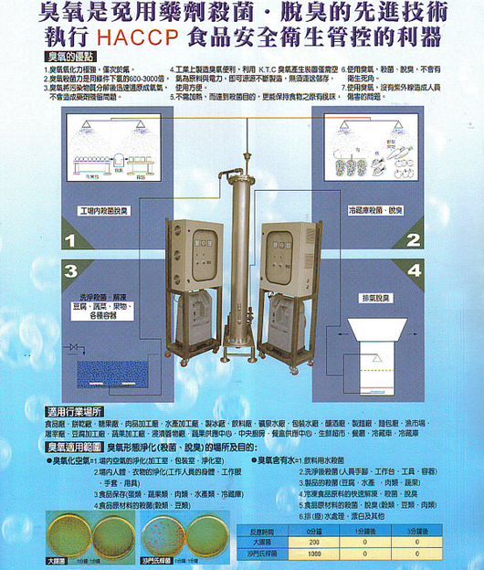

Slide 3
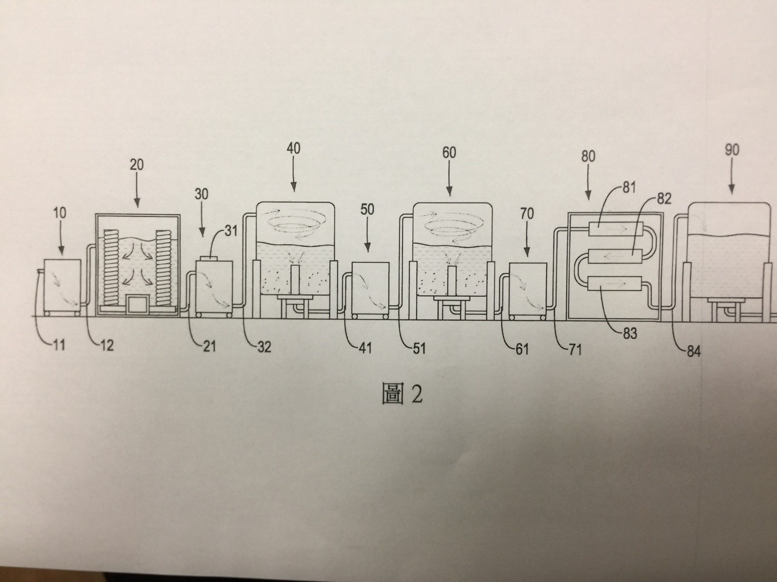
臭氧水釋譯圖

Slide 4
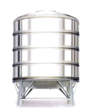
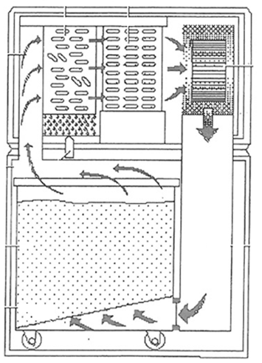
淨漿儲水槽
濾泥儲水槽
回流
淨漿過濾系統
汙泥乾燥系統

Slide 5
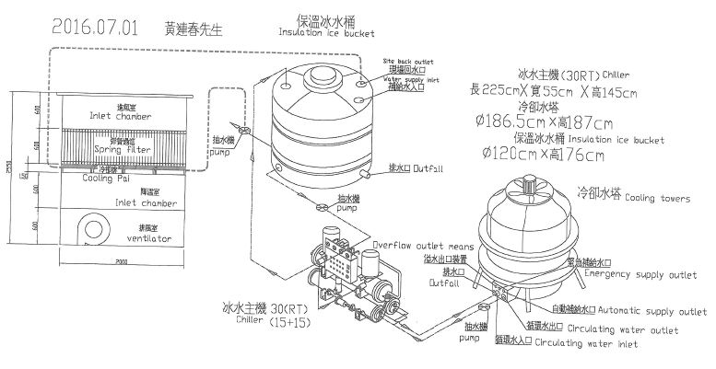

Slide 6
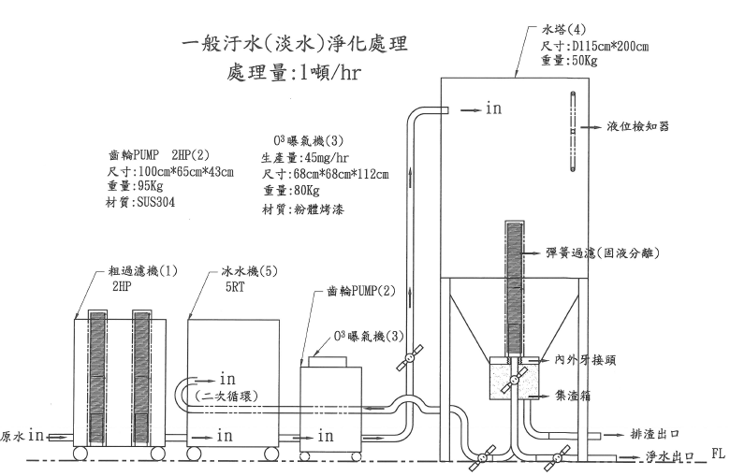

Slide 7
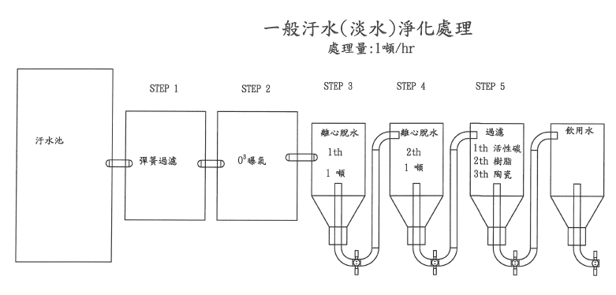

Slide 8
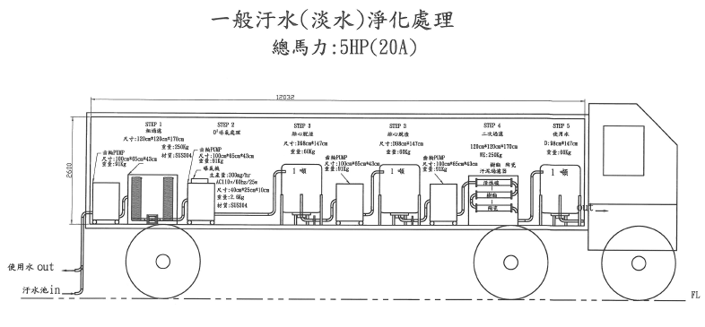

Slide 9
Environmental Protection Industry innovation Research and Development Promotional Plan
Innovative O3 treatment system for Sludge and wastewater
True Ten Industrial Co., Ltd.
www.trueten.com.tw
No. 511 Dongxing Rd. Dali Dist. Taichung City 412 Taiwan, R.O.C.
Plan Coordinator: Shun-Tsung Lu
June, 2017

Slide 10
Ozone (O3) is a advanced technology for Sterilization, Deodorization, and implementation for food safety and health control.
Ozone (O3) benefits:
Oxidation is strong, only next to fluorine.
Ozone sterilization is 600~3000 times more than the chlorine under the same conditions.
Ozone decomposed pollution matter and rapidly turns into oxygen, does not cause chemical residue problem
Industrial made Ozon can be made with air and electricity as raw material. Can be made without delivery of storage, easy of use.
No need to be heating up to achieve disinfection purposes, food may keep its original flavor.
Ozone may be use for disinfection and deodorization. No health issue concerns.
No UV rays to cause any kind of injury.

Slide 11
Ozone may apply to the following industrial locations:
Food factory, biscuit factory, candy factory, meat processing plant, fish processing plant, ice plants, beverage plants, mineral water factory, packaging works, breweries, noodle factory, bakery, fish markets, slaughterhouses, tofu plant, fruit and vegetable processing plants, fruits and vegetables supply center, central kitchen, lunch boxes and supply center, fresh supermarket, restaurant, refrigerator, freezer

Slide 12
Ozone may be used to the following applications:
Ozone Air:
Indoor air purification (processing room, packing room, clean room
Purification for human body, clothing (staff clothing, gloves, and utensils)
Food (eggs, vegetables, fruits, meat, seafood, and any other cold storage products)
Raw food materials sterilization (cereals and legume)
Ozone water:
Drinking water purification
Rinse and antiseptic (human hands/feet, workstations, tools, containers)
Sterilization of food products (tofu, seafood, meats, fruits, and vegetables)
Fast thawing of frozen food, sterilization, deodorization
Sterilization and deodorization of raw food materials (cereals, pulses, meats)
Treatment and bleach for wasted water

Slide 13
Ozone treatment for Coli and Salmonella
Response Time | 0 min | 1 min | 3 mins
Coli | 200 | 0 | 0
Salmonella | 1000 | 0 | 0

Slide 14
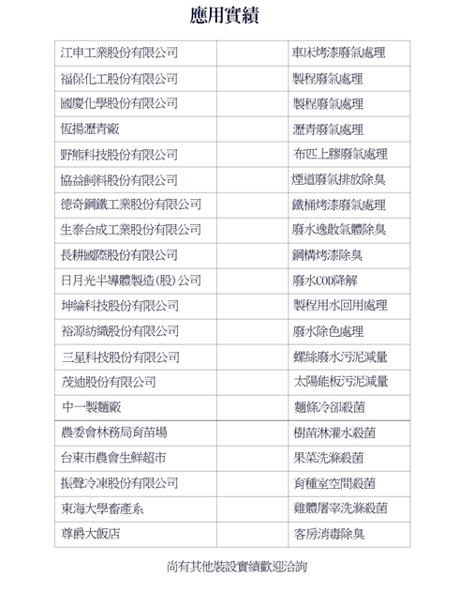

Slide 15
Proven Treatment cases
Company Names | Treatments
Kian Shen Co., LTD | Turning furnace paint exhaust treatment
Fu Pao Chemical Co., LTD | Processed gas treatment
Kuo Ching Chemical Co., LTD | Processed gas treatment
Heng Yang Asphalt Co., Ltd. | Asphalt gas treatment
Wild Bear Technology Co., LTD | Cloth rubber gas treatment
Shye Yih Feeding Co., LTD | Deodorize fule gas emissions
Dur Chyi Industries Co., LTD | Paint exhaust from steel drum treatment
Syn-Tech Chem & Pharm. Co., LTD | Deodorize scattered gas from wasted water
Everharvest Coating Co., LTD | Deodorize steel structure paint
ASE Group Semi Conductor | Wastewater COD degradation
Kun Lun Technology Co., LTD | Processed recycle water treatment
Yu Yuang Group | Waste water treatment
San Shing Fastech Corp. | Sludge waste reduction from screw production
Motech Industries, Inc. | Solar panel sludge reduction
Zhong-I Noodle Factory | Noodle cooling sterilization
Council of Agriculture, Executive Yuan | Water for the forest sterilization
Tai-Dong Farmers' Supermarket | Fruit and vegetables washing water sterilization
Shin-Sei Frozen Foods Co., LTD | Breeding chamber Sterilization
Tunghai University, Department of Animal Science and Biotechnology | Chicken body washing germ sterilization
Monarch Plaza Hotel | Room disinfection and deodorant

Slide 17
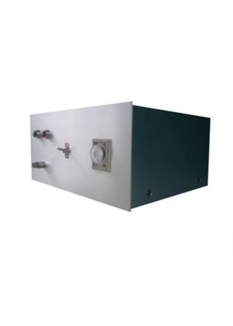
Ozone unit for Experimental Application
Product Spec:
Rated Voltage: AC110V 50/60Hz
Rated efficiency: 500W
Ozone output: 0~10 g/HR
Ozone Concentration: 0~40 g/cum
Dimensions: 180 x 400 x 300mm
Product advantages:
This product uses ceramic flat-plate CORONA discharge method, contains a variety of system protection devices, the ozone output with stability. Simple to install, easy to use.
Modelized structure, easy maintainance.
KT-40/PSA

Slide 19
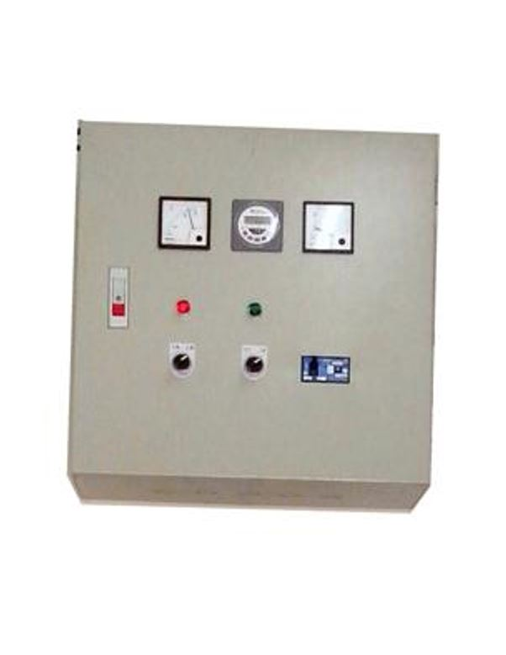
High Concentrations Ozone unit for Commercial use
Product Spec:
Rated Voltage: 220V 50/60Hz
Rated efficiency: 450 W
Ozone output: 10 g/HR
Ozone Concentration: depends on input source.
Dimensions: 500 x 500 x 200mm
Product advantages:
This product uses ceramic flat-plate CORONA discharge method, contains a variety of system protection devices, the ozone output with stability. Simple to install, easy to use.
Modelized structure, easy maintenance.
KT-40/PSA1

Slide 21
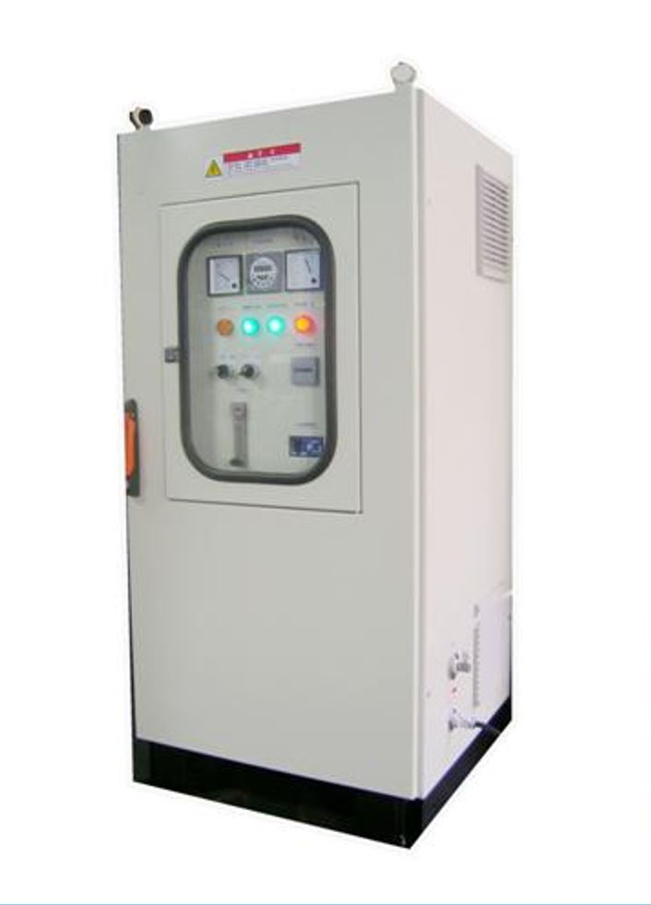
High Concentrations Ozone unit for Commercial use
Product Spec:
Rated Voltage: 220V 50/60Hz
Rated efficiency: 700 Rated
Ozone output: 40 g/HR
Ozone Concentration: 70~120 g/cum
Dimensions: 1300 x 600 x 600mm
Product advantages:
This product uses ceramic flat-plate CORONA discharge method, contains a variety of system protection devices, the ozone output with stability. Simple to install, easy to use.
KT-40/PSA

Slide 23
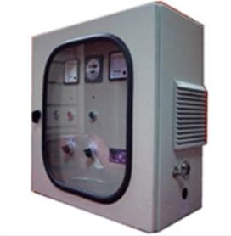
High Concentrations Ozone unit
Product Spec:
Rated Voltage: 220V 60Hz
Ozone output: 40 g/HR
Ozone Concentration: 140 g/cum
Dimensions: 500 x 500 x 250mm
Product advantages:
This product uses the flat discharge, forward type gas cooling, stable ozone output.
Application Scope: A variety of water treatment, air purification sterilization. deodorizing application.
KT-40/PSA

Slide 25
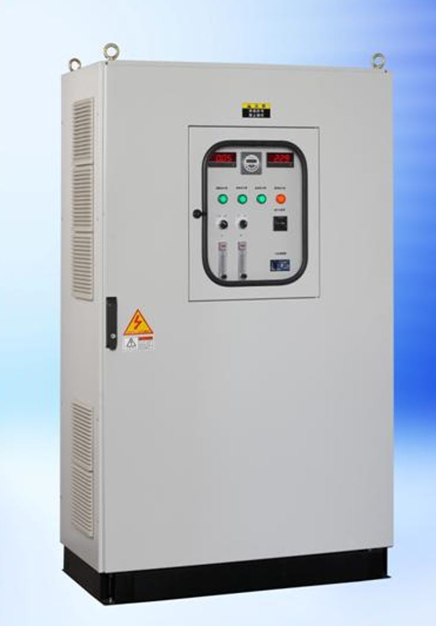
High Concentrations Ozone unit
Product Spec:
Rated Voltage: 220V 50/60Hz
Power Rating: 2500W
Ozone output: 160 g/HR
Ozone Concentration: 100~160 g/cum
Dimensions: 500 x 500 x 250mm
Product advantages:
This product uses the flat discharge, forward type gas cooling, stable ozone output.
Application Scope: A variety of water treatment, air purification sterilization. deodorizing application.
KT-160/PSA

Slide 27
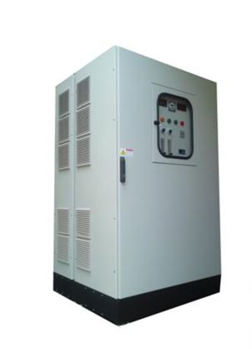
High Concentrations Ozone unit
Product Spec:
Rated Voltage: 220V 50/60Hz
Power Rating: 8000W
Ozone output: 1000 g/HR
Ozone Concentration: 100 g/cum
Dimensions: 200 x 100 x 130mm
Product advantages:
This product uses the flat discharge, forward type gas cooling, stable ozone output.
Application Scope: A variety of water treatment, air purification sterilization. deodorizing application.
KT-1000/PSA

Slide 29
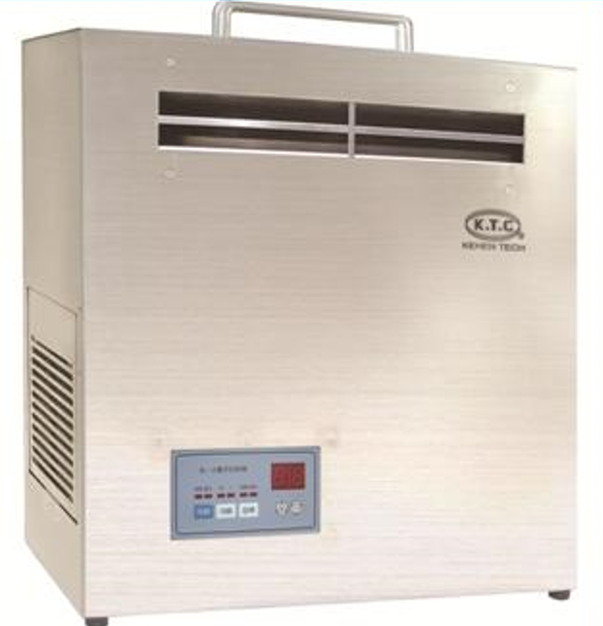
Open Space Air Cleaning Ozone unit
Product Spec:
Rated Voltage: 110V 60Hz
Power Rating: 200W
Ozone output: 8000 g/HR
Ozone Concentration: 30 g/cum
Dimensions: 420 x 420 x 150mm
Product advantages:
This product uses the flat discharge, forward type gas cooling, stable ozone output.
Application Scope: A variety of water treatment, air purification sterilization. deodorizing application.
KT-A8000/PSA

Slide 31
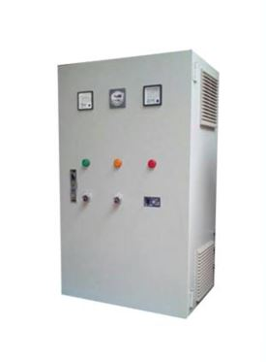
Open Space Air Cleaning Ozone unit
Product Spec:
Rated Voltage: 220V 50/60Hz
Power Rating: 1200W
Ozone output: 20 g/Hr
Ozone Concentration: 70 g/cum
Dimensions: 1000 x 600 x 400mm
Product advantages:
This product uses the flat discharge, forward type gas cooling, stable ozone output.
Application Scope: A variety of water treatment, air purification sterilization. deodorizing application.
KT-AW20/PSA

Slide 32
市場應用情形 Market Application

Slide 33
興農超市PC廠 Sinon Supermarket PC Factory

Slide 34
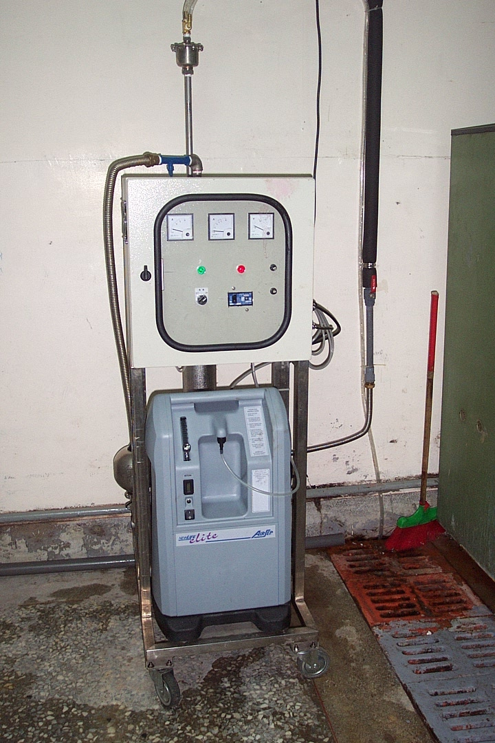
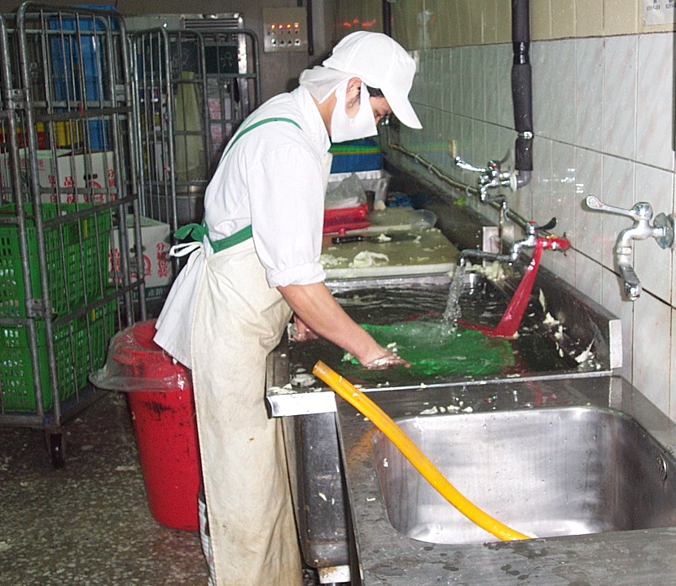

Slide 35
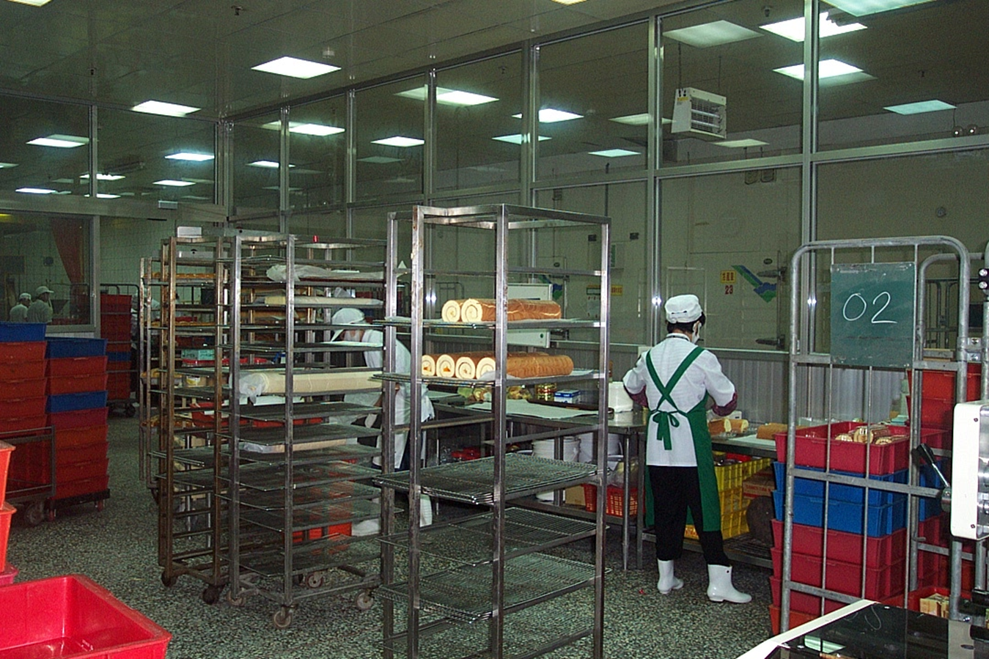

Slide 36
漢光果菜處理廠 Hankuan Fruit and Vegetable Process Factory

Slide 37
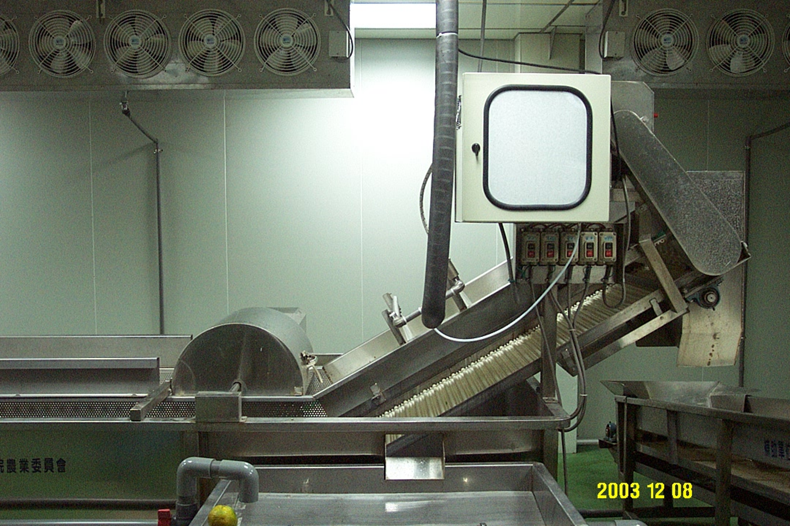
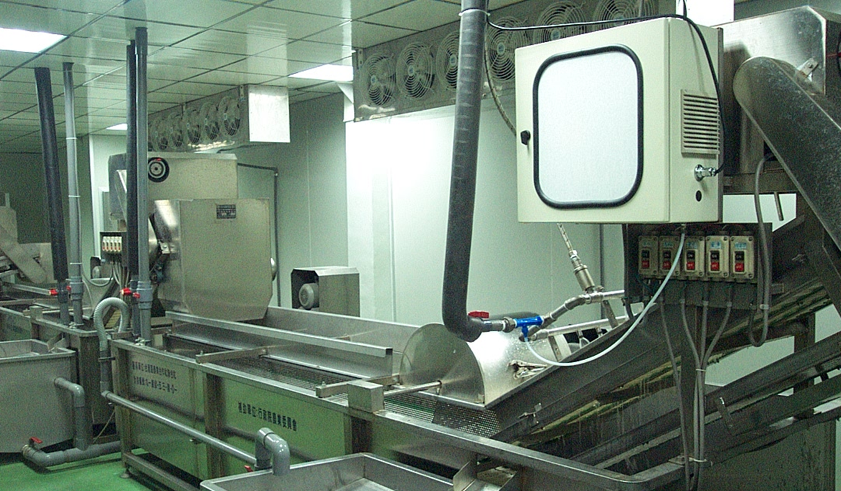

Slide 38
憶霖紀文食品公司 YiLinKiBun Food Company

Slide 39
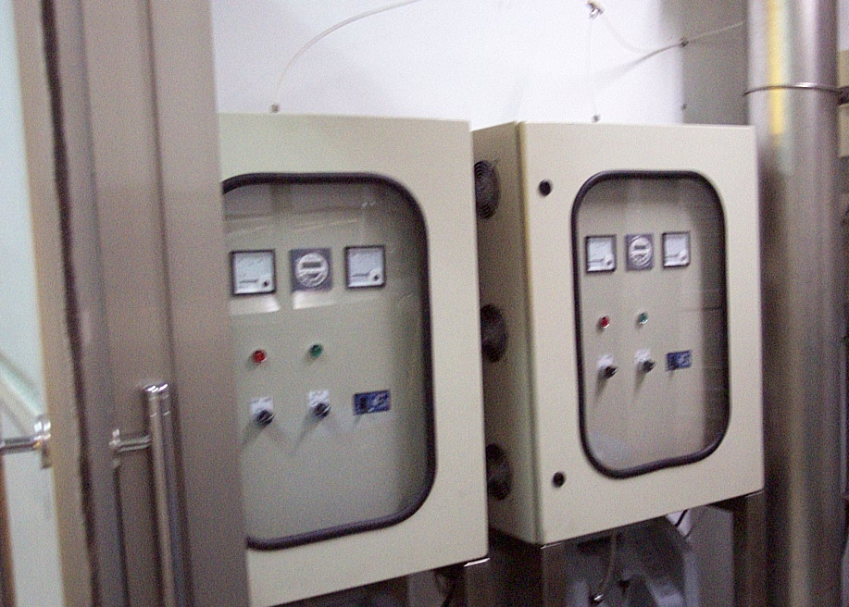

Slide 40
成功瀝青廠 ChengGong Asphalt Plant

Slide 41
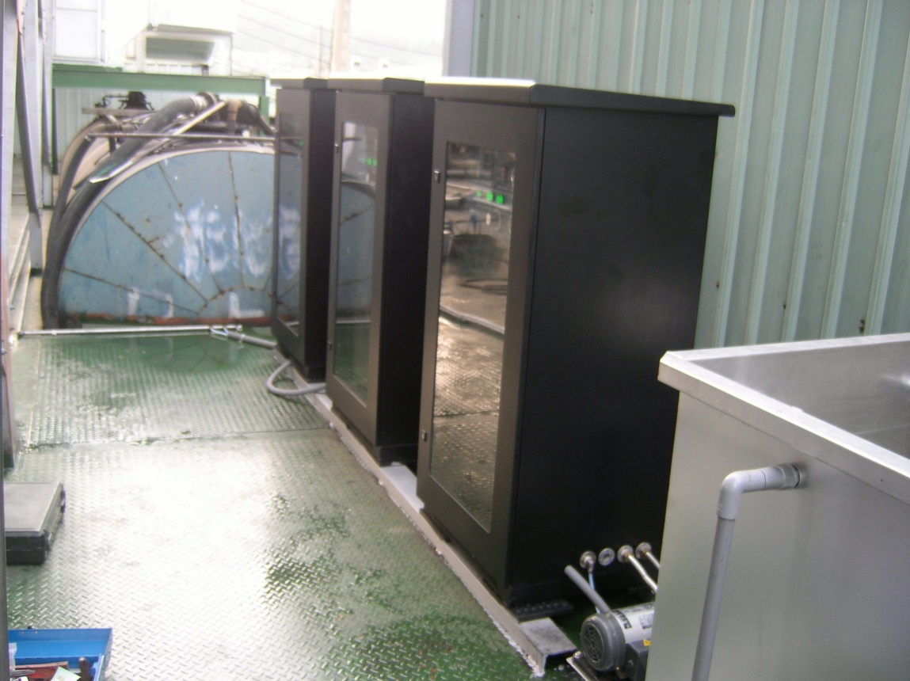
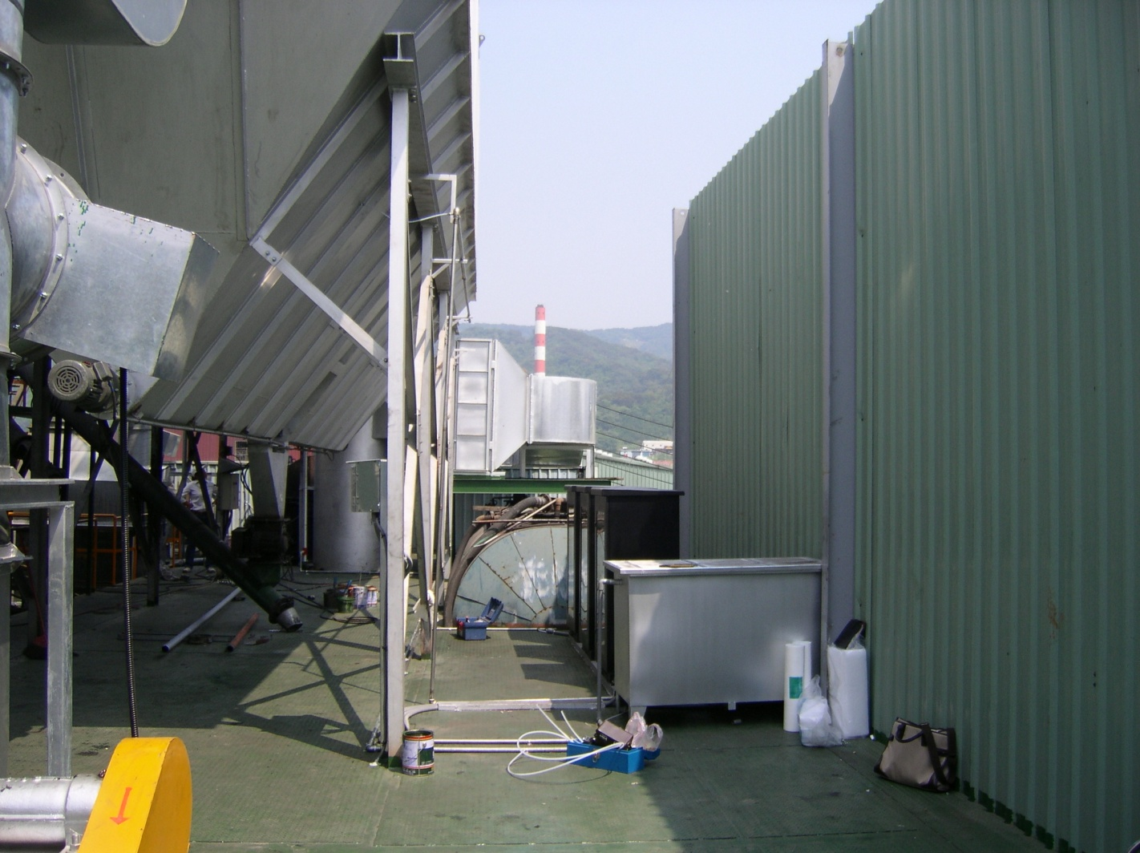

Slide 42
阿官火鍋中央廚房 A-Kuan Hot Pot Central Kitchen

Slide 43
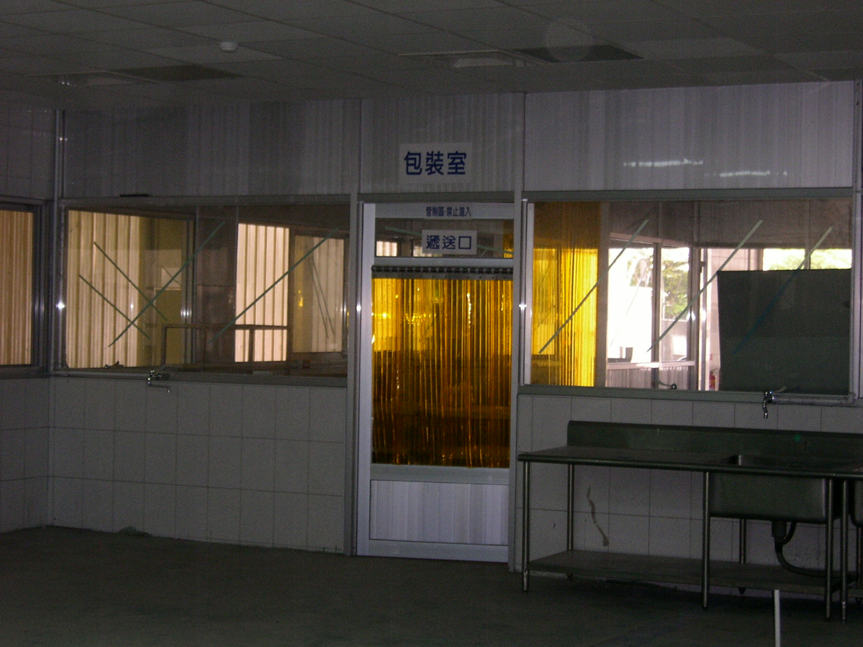

Slide 44
福保化學廠 FuPao Chemical Plant

Slide 45
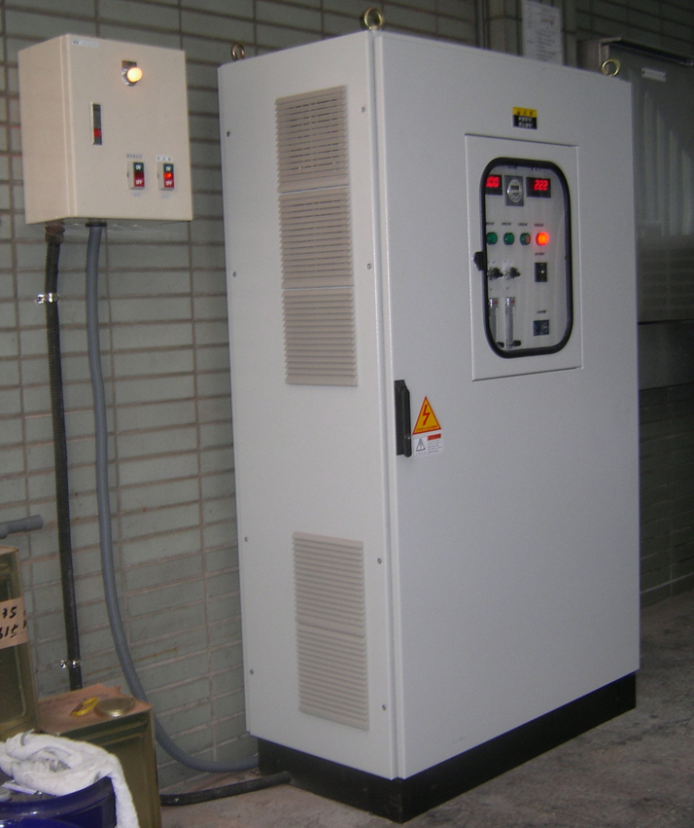
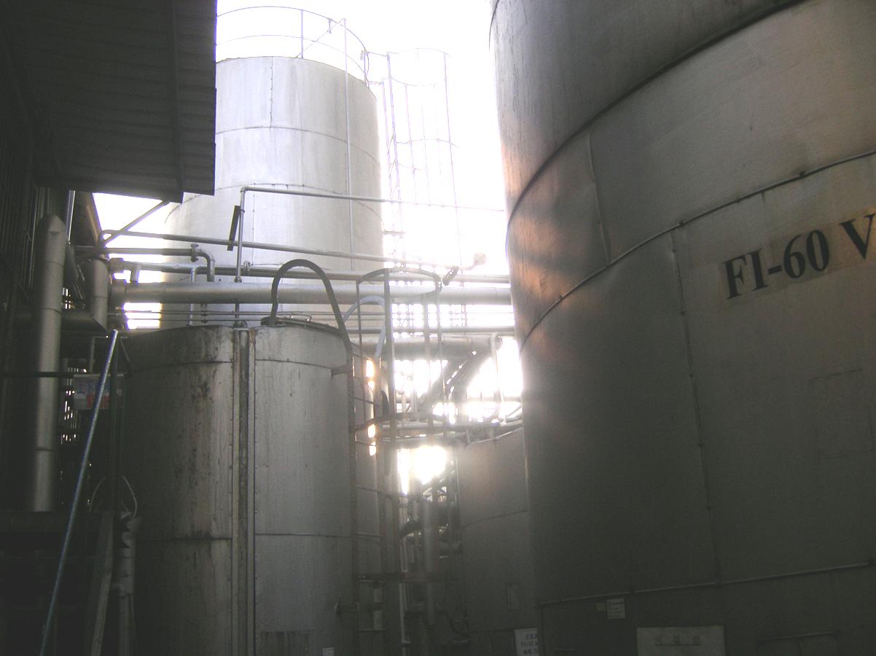

Slide 46
廣海海產 Kuan Hai Seafood

Slide 47
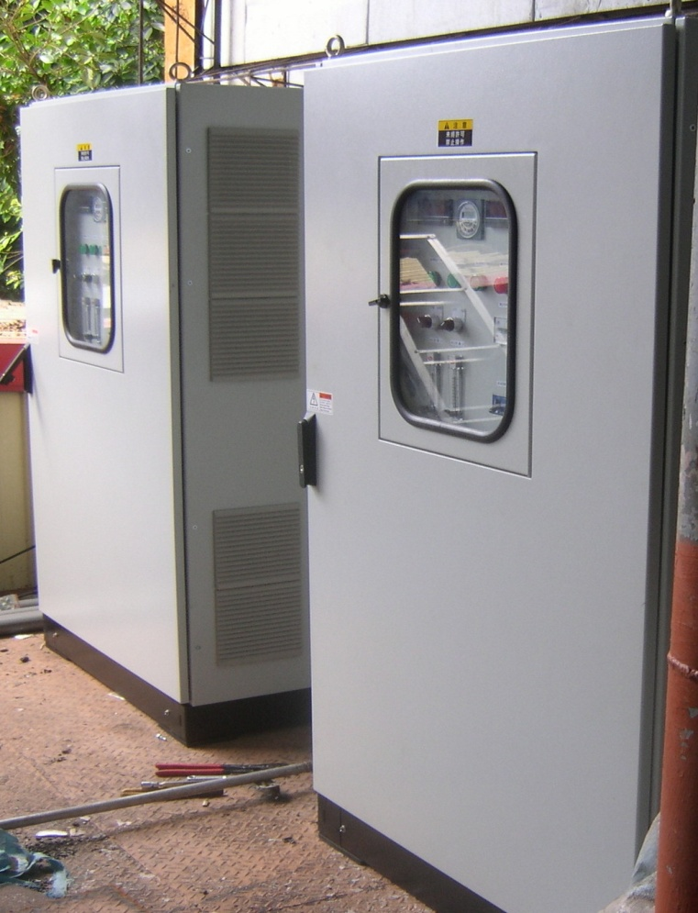
棋益瀝青廠 Arch Asphalt Plant

Slide 48
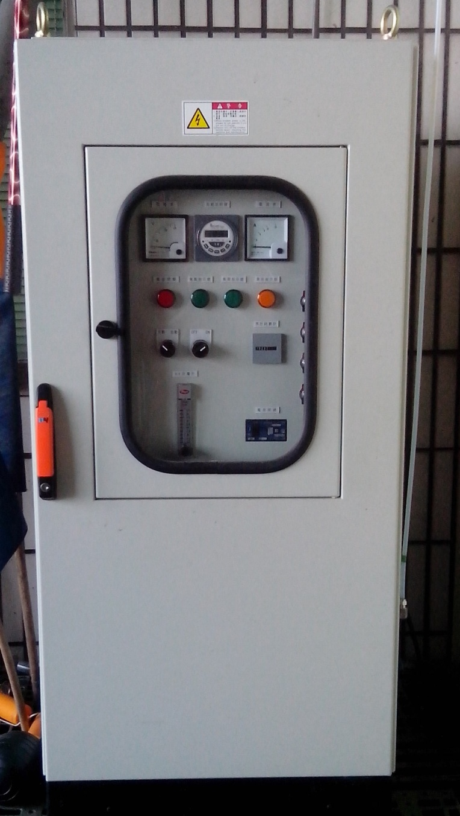
七座農場 Chi-Zho Farm

Slide 49
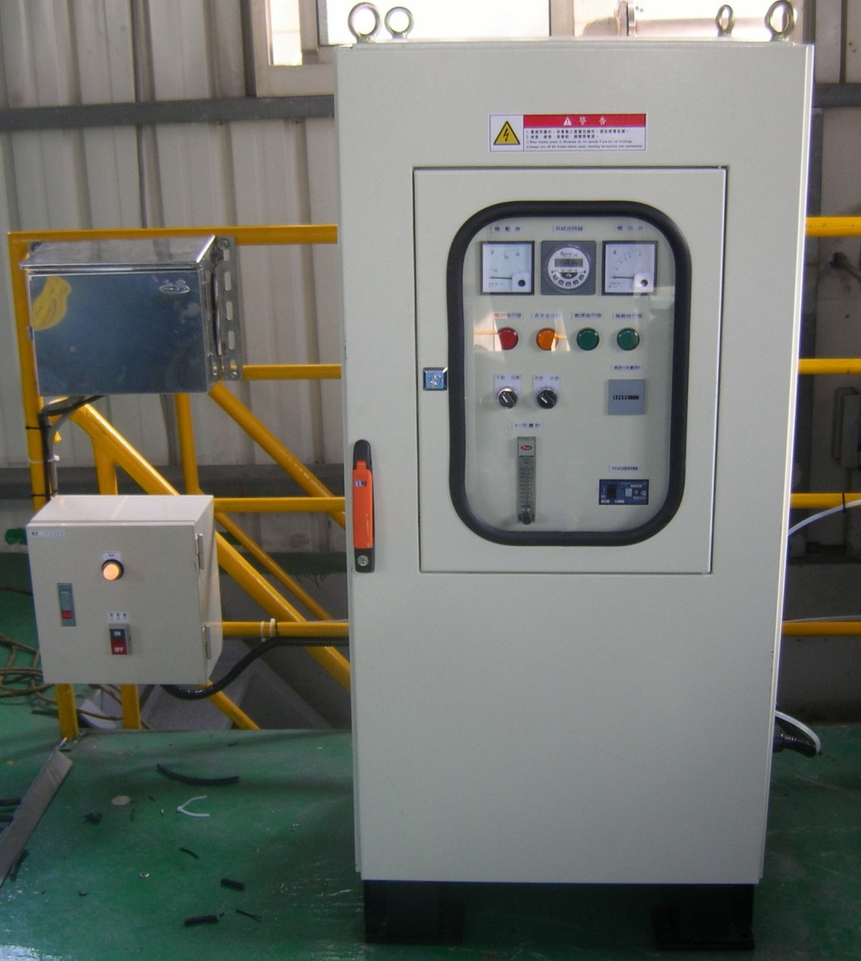
生泰合成 Syn Tech Factory

Slide 50
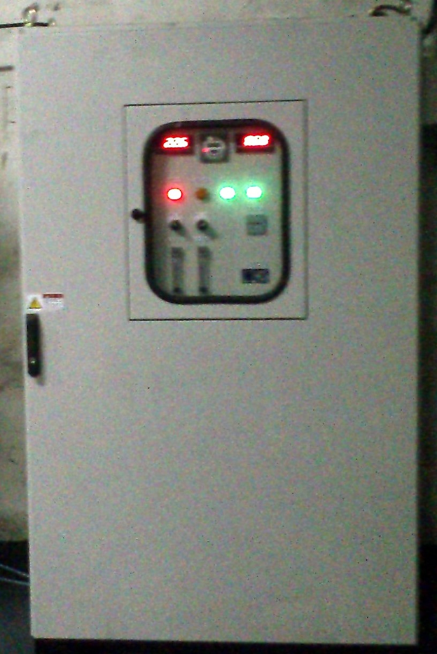
江申車斗烤漆 Kian Shen Car Paint

Slide 51
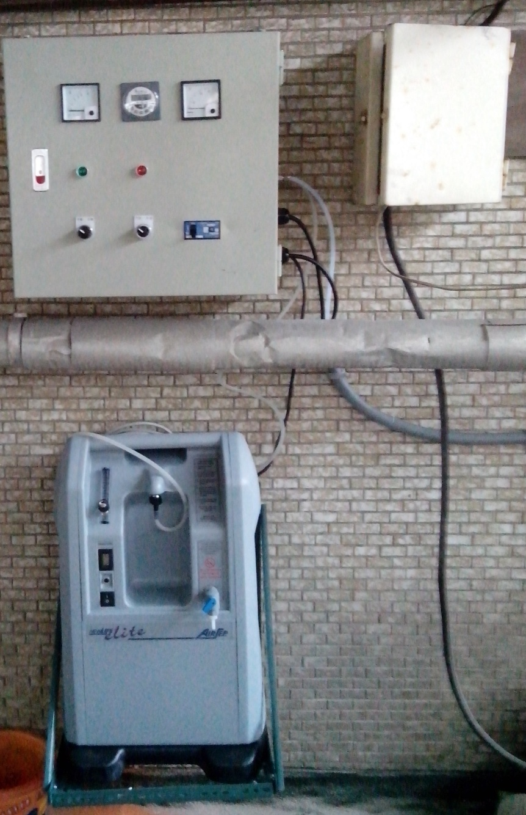
來來水產 Lai Lai Seafood

Slide 52
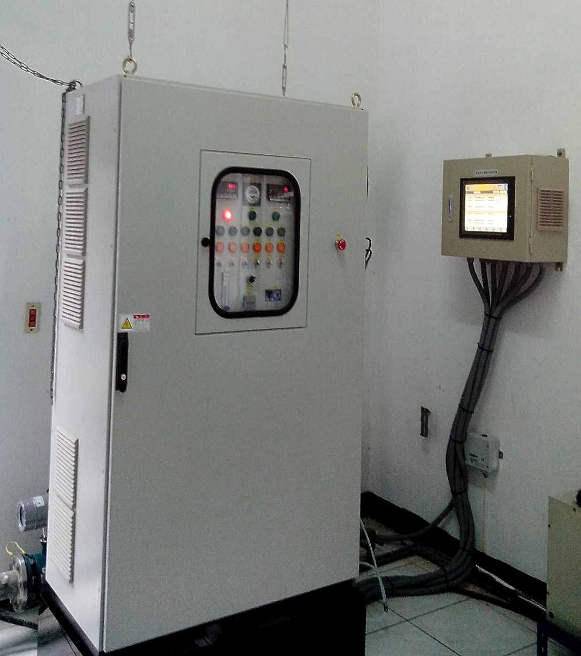
坪林淨水廠 PingLin Water Purification Plant

Slide 53
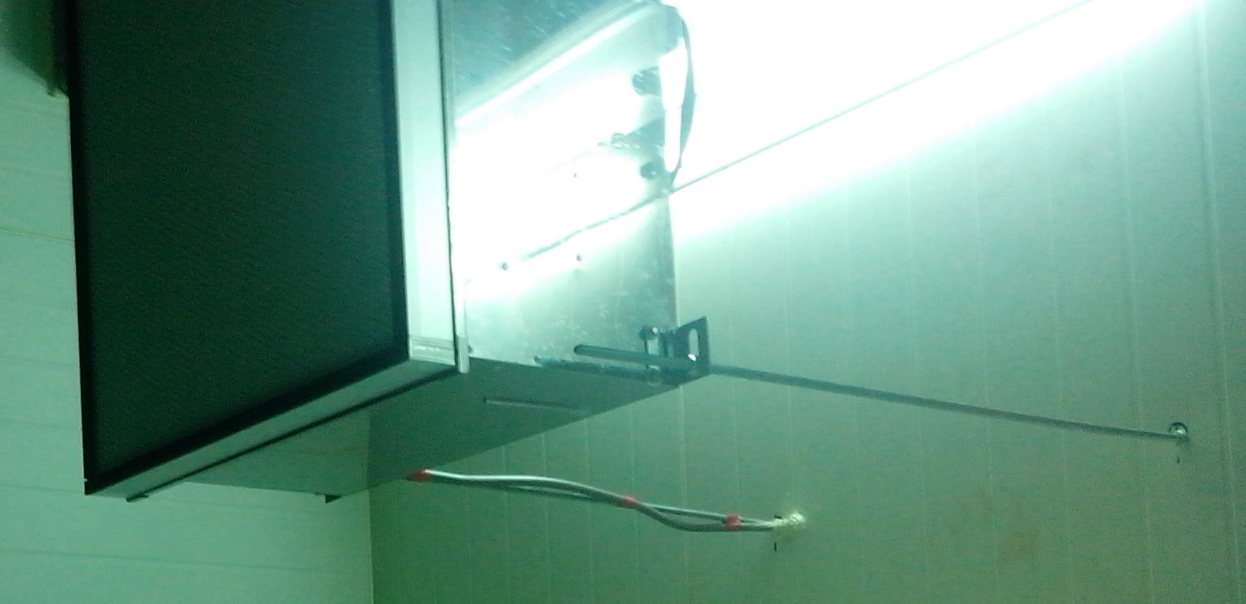
和睦農場 Harmony Farm

Slide 54
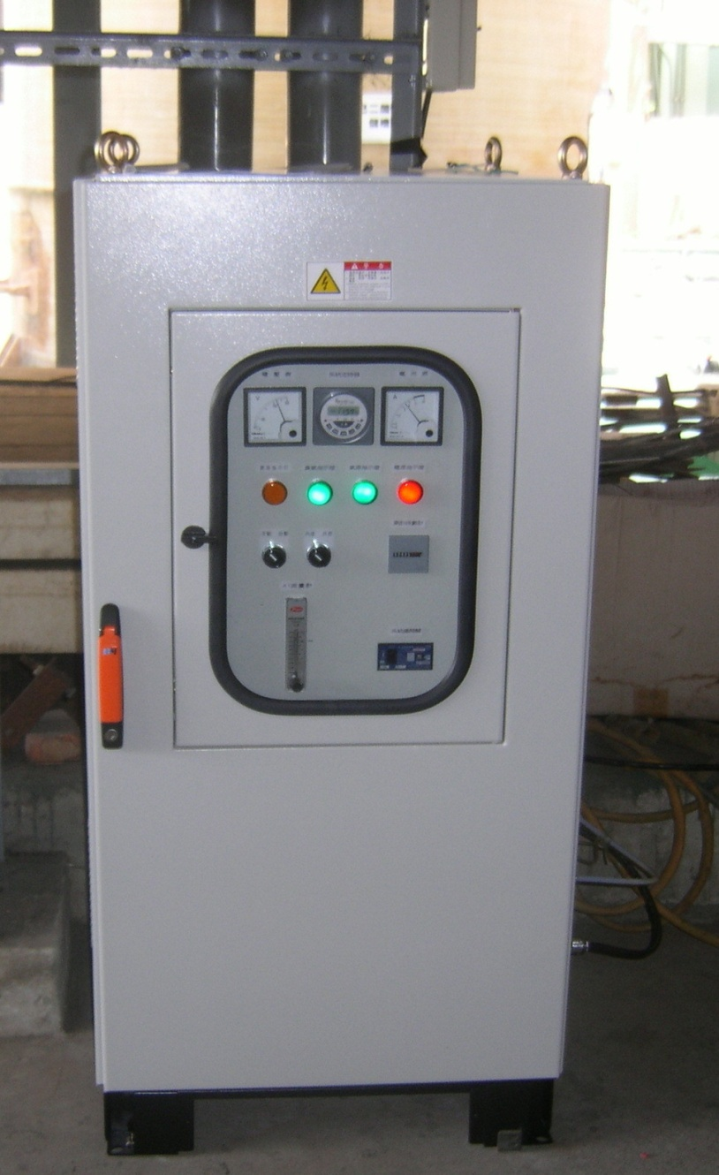
坤綸科技 Kun Lun Technology Co

Slide 55
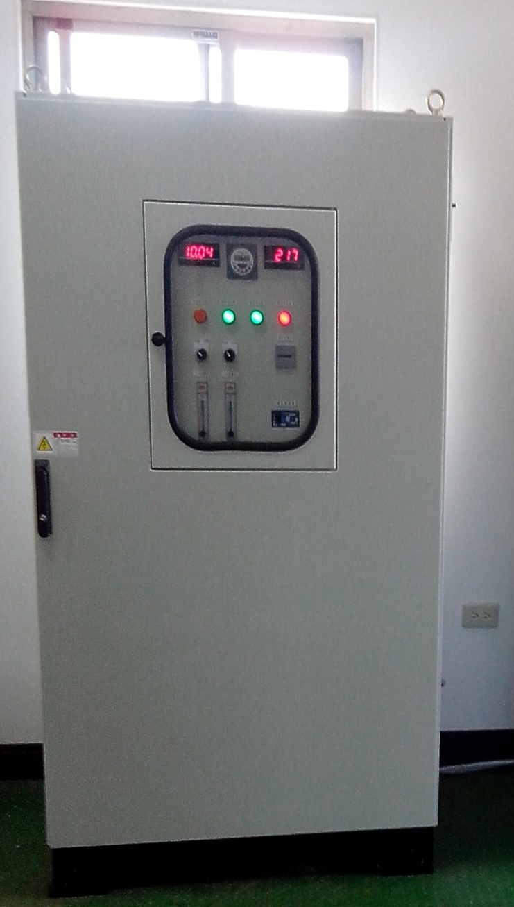
東利瀝青廠 Dong-Li Asphalt Plant

Slide 56
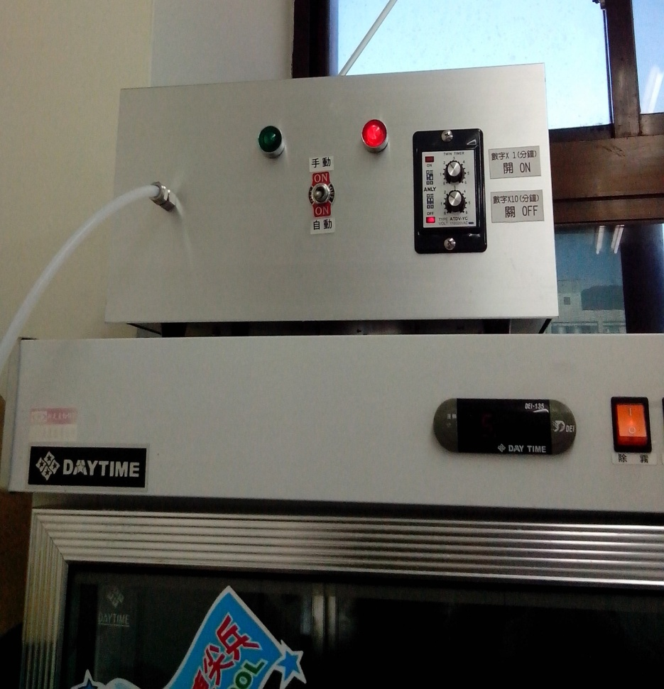
阿婆壽司 A-Po Sushi

Slide 57
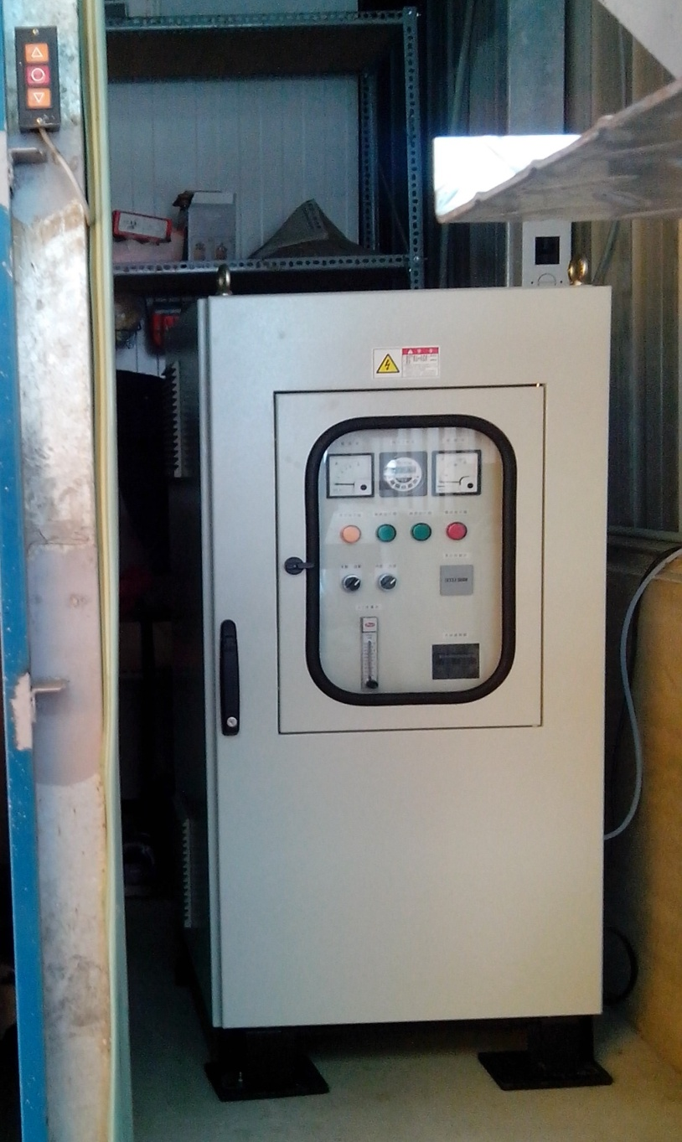
晏廷農場 Yenting Farm

Slide 58
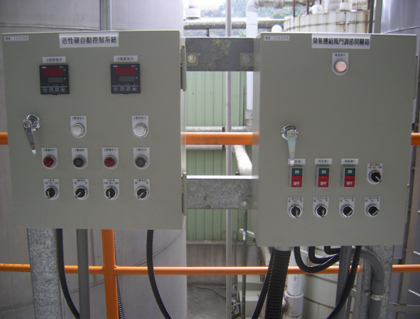
國慶化工 KuoChing Chemical

Slide 59
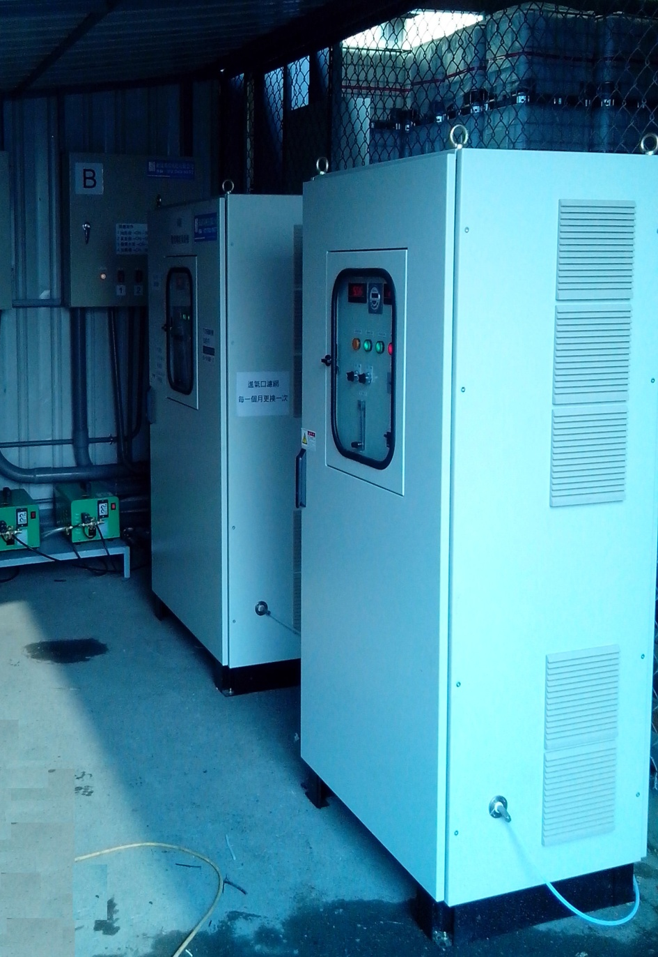
德奇油桶烤漆 DerChi Oil Barrels Painting

